Slide 1
Smart Assistant System for people with Cerebral Palsy

Slide 2
Problem Statement
A person suffering from Cerebral Palsy feels various difficulties in their day to day life, from restricted muscle movements, to frequent loss of memory. Our product aims to make life better for the person facing these issues.

Slide 3
Solution
A gesture based chair with obstacle avoidance
Voice based memo system

Slide 4
Product
Smart Chair : Gesture Based movement of chair along with automatic obstacle avoidance
Smart Memory : Voice controlled memo
Health Monitoring : Pulse rate values sent on IoT Hub

Slide 5
Product Features
Constant Heart Rate Monitoring
Movement of Chair based on gesture
Automatic Obstacle Avoidance
Saving a voice based memo on the system

Slide 6
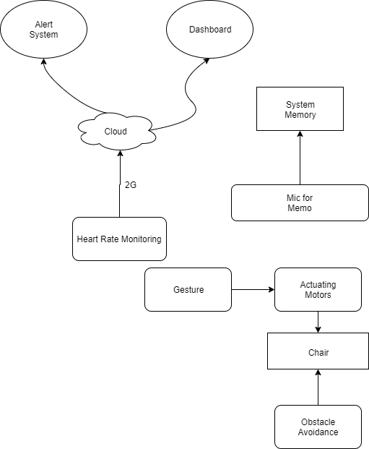
Product Architecture

Slide 7
Product Life Cycle Development
Introduction Stage : Cost for manufacturing is high. Can be given out to specific people with the condition for testing.
Growth Stage : The product takes off. Production costs may decrease. The overall profit will increase. Money can be reinvested into the business and in overall improvements of the system
Maturity Stage : Sales growth begin to decline, company reaches its highest point in demand cycle, and advertising strategies have minimal impact on sales growth

Slide 8
CAPEX and OPEX
CAPEX :
Chair structure : 371$
Automation Devices : 371$
Rechargeable Batteries : 37$
Market Value : 930$
OPEX :
Network - 2G : Less than 5$/mo

Slide 9
Security
Hardware Security : Lock on Wheels
Software Security : Symmetric Shared Key on IoT Hub, Face Lock

Slide 10
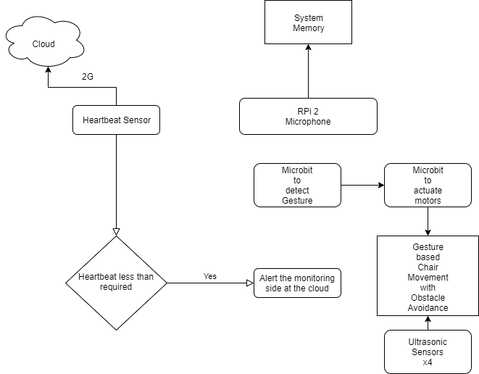
Project
Architecture

